Slide 1
How To Make Good Survey Questions
Kelly Coons and Kalena Hansen del Rey

Slide 2
Option 5: Teaching tool
With this option, you will choose one of the course topics of particular interest or importance to you and create a tool to teach it to others. Formats could include a classroom activity or workshop with detailed learning objectives and lesson plan; a series of worked-out concept checks; a teaching case that illustrates a core concept; materials that extend or deepen students’ learning on the topic beyond what we covered in the course; or something else of your own design.
Please specify the audience you have in mind (future EdM students, program managers, superintendents of schools, etc.) and their prior level of expertise with the content. Your tool should accurately explain the concept(s) you’re teaching, should set rigorous expectations for student learning, and should reflect a level of depth equivalent to the other final project options. For example, a plan for a 10-minute classroom activity would be insufficiently deep, even if it was technically accurate and rigorous. Creativity and humor are welcome!
This is also a new option this year, so I don’t have examples from prior years to share.

Slide 3
Lesson Objectives (HCCPS; ELA 9-10)
Students can generate survey questions together as a class, then independently by listening to the mini lecture, discussing ideas as a class, then using resources, such as the Identity Sorting Dials packet, to create 3 survey questions on their own.
Notes:
http://standardstoolkit.k12.hi.us/common-core/language-arts/language-arts-grades-9-10-common-core-standards/index.html

Slide 4
Unit Objectives: Background Context (HCCPS; ELA 9-10)
Participants will be able to:
Plan, edit, and revise writing in order to address the audience with the specific purpose of writing clear, coherent, and relative survey questions by creating a pilot survey and by receiving feedback on the pilot survey from the participants.
2) Students and teachers will use technology to produce a survey and to publish research results by using technology’s capacity to collaborate together on a shared document and to display information in a clear and meaningful manner for the intended audience. (School stakeholders)
3) Conduct short as well as more sustained research projects to answer a question (including a self-generated question) by asking what is happening in the school culture and what would students like to see change in the school culture. Do teachers feel the same way that students feel about the school? Participants will conduct interviews or use photovoice to gather results.
4) Address validity and reliability by gathering relevant information and by coding, cleaning, and member checking the data discovered and by integrating information into the text selectively to maintain the flow of ideas, avoiding plagiarism and following a standard format for citation.
Notes:
http://standardstoolkit.k12.hi.us/common-core/language-arts/language-arts-grades-9-10-common-core-standards/index.html

Slide 5
Overview
Formative assessment checks: survey question analysis
Summative assessment: write, distribute and analyze survey
Know which data are worth using, which aren’t, and why! Harness the power of data and stories to inspire change!
Notes:
http://standardstoolkit.k12.hi.us/common-core/language-arts/language-arts-grades-9-10-common-core-standards/index.html

Slide 6
Unit Plan: Background Context
4-week interdisciplinary unit between Social Studies, English, and Math in a Hawaiian public high school 9th grade curriculum.
ELA: Read two novels (To Kill A Mockingbird and The Hate U Give), write reflections, class discussions.
Social Studies: background history: The Great Depression, The Dust Bowl, Civil Rights Movements: reading, quizzes, games, graphic presentations.
Create research question.
Math: survey creation.
Math: survey distribution.
Math: survey analysis, data displays.
Arts-based analysis: coding; axial coding.
Compare classes' results.
Further presentations of results, recommendations, and suggestions to school/district administration.
You are here: introduction to survey design lesson.

Slide 7
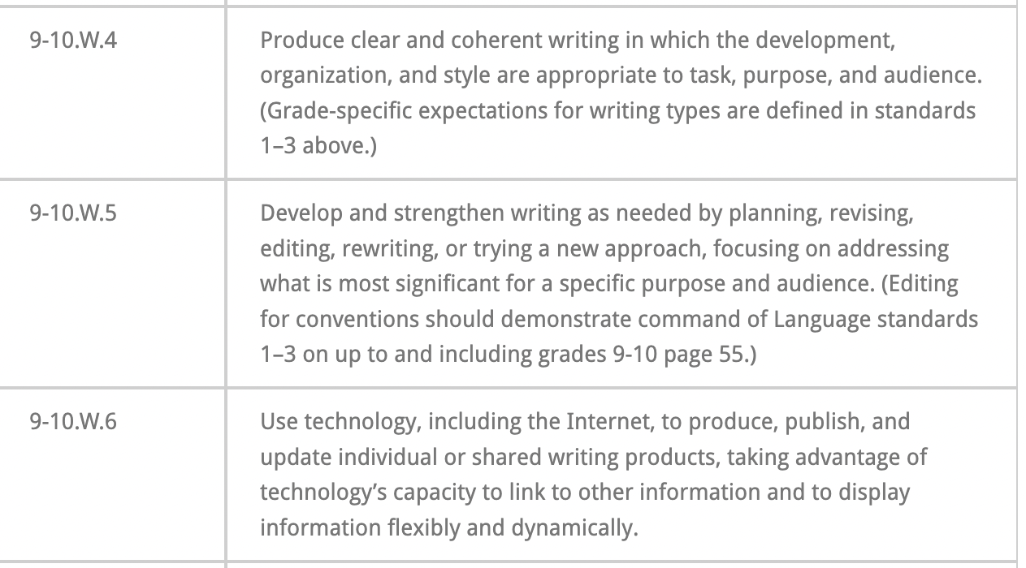
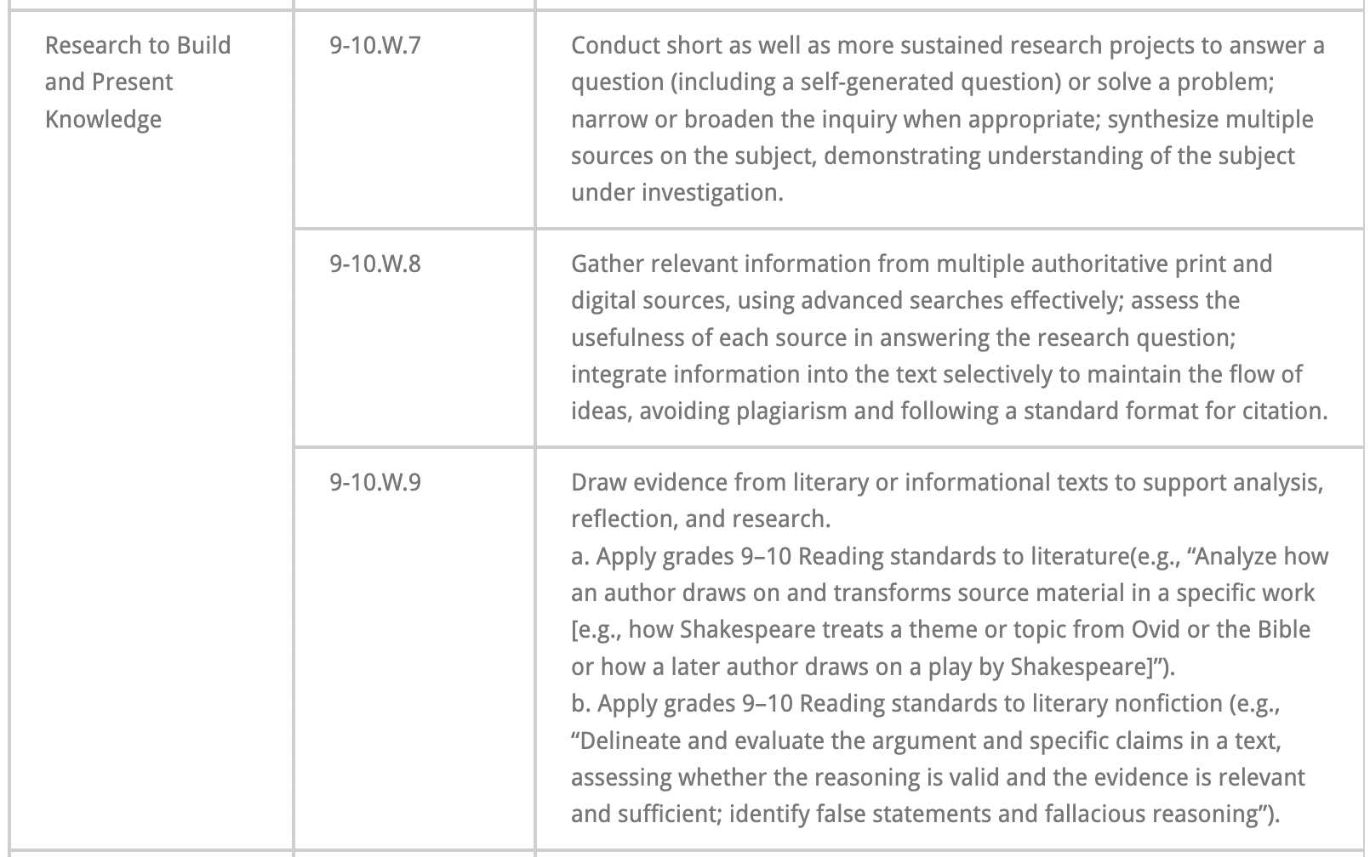
Relevant Common Core Standards
(Hawaii Content & Performance Standards :: Standards Toolkit » Language Arts Grades 9-10 Common Core Standards, n.d.)
Notes:
http://standardstoolkit.k12.hi.us/common-core/language-arts/language-arts-grades-9-10-common-core-standards/index.html

Slide 8
You've been picked to fill out a survey. How do you feel?
What do you like about filling out surveys?
What do you not like about filling out surveys?
Notes:
Students have already filled out a survey, the Panorama survey, at this time in the year (mandatory state survey).

Slide 9
What does the word "survey" mean to you?
A survey is when you ask questions with the purpose of learning what your community thinks.
Surveys can ask questions about opinions and/or traits of the group (demographics).
Notes:
Students have already filled out a survey, the Panorama survey, at this time in the year (mandatory state survey).

Slide 10
You are creating a survey!
Congratulations! There are so many people in your high school community with information to share, and a survey is a great way to reach them.
But the language you use in your survey matters....
Krause, H. (2022, April 28). Introducing: Identity Sorting Dials » We All Count. We All Count. https://weallcount.com/2022/04/28/introducing-identity-sorting-dials/

Slide 11
Fit
Would you agree that this term accurately describes you (even if it isn't your preference)?
Are you in school today?
Yes
No
Are you a child or an adult?
Notes:
http://standardstoolkit.k12.hi.us/common-core/language-arts/language-arts-grades-9-10-common-core-standards/index.html

Slide 12
Fit Dials
"A badly fit category is wide open for assumptions, prejudice, and misinterpretations of what the data really means."
Less Fit
More Fit

Slide 13
Is This A Good "Fit"?
Check the box that best describes your race. You may only check one.
Black
Hispanic
Asian
Pacific Islander
White
Notes:
http://standardstoolkit.k12.hi.us/common-core/language-arts/language-arts-grades-9-10-common-core-standards/index.html

Slide 14
Is This A Good "Fit"? Class Share-Out
What did you notice?
How did you feel?
Do you feel like you can check a box and the answer is accurately describing you?
How could we make the question better (access needs)?
Notes:
http://standardstoolkit.k12.hi.us/common-core/language-arts/language-arts-grades-9-10-common-core-standards/index.html

Slide 15
Fit: Triads
In your triads, create three (3) fit questions.
Factors To Consider:
How long does it take to read the question?
How much of the text of the question helps you answer the question? / What is distracting?
What access needs should we consider when writing a survey question?
Do we require that all questions be answered? Why or why not?
Notes:
http://standardstoolkit.k12.hi.us/common-core/language-arts/language-arts-grades-9-10-common-core-standards/index.html

Slide 16
Specificness
Is this a way you like to use to describe yourself?
Which island in Hawai'i are you from?
Hawai'i
Maui
Moloka'i
O'ahu
Kaua'i
Ni'ihau
Which flavors of the following ice creams best describes your personality?
Vanilla
Chocolate
Strawberry
Coffee
Cookie dough
Pistachio
Notes:
http://standardstoolkit.k12.hi.us/common-core/language-arts/language-arts-grades-9-10-common-core-standards/index.html

Slide 17
Specificness Dials
"...it allows us to ask more exact questions and get more exact answers."
Less Specific
More Specific

Slide 18
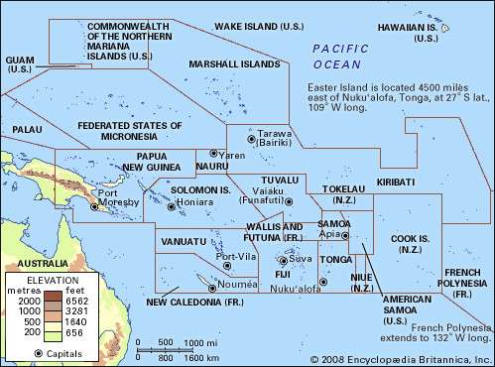
Is This Good "Specificness?"
Pacific Islander
Everyone living in an area on this map could be referred to as a Pacific Islander.
Notes:
http://standardstoolkit.k12.hi.us/common-core/language-arts/language-arts-grades-9-10-common-core-standards/index.html

Slide 19
Is This Good "Specificness"? Class Share-Out
Could you find yourself on the map?
How did you feel?
Do you use the term "Pacific Islander" to describe yourself? Is there another term you prefer?
Notes:
http://standardstoolkit.k12.hi.us/common-core/language-arts/language-arts-grades-9-10-common-core-standards/index.html

Slide 20
Specificness: Triads
In your triads, create three (3) specificness questions.
Factors To Consider:
How long does it take to read the question?
How much of the text of the question helps you answer the question? / What is distracting?
What access needs should we consider when writing a survey question?
Do we require that all questions be answered? Why or why not?
Notes:
http://standardstoolkit.k12.hi.us/common-core/language-arts/language-arts-grades-9-10-common-core-standards/index.html

Slide 21
Ease
How does the question's length and/or wording affect your motivation to answer it?
Did you wear a hat today?
Yes
No
Are you feeling good today?
Yes
No
Notes:
http://standardstoolkit.k12.hi.us/common-core/language-arts/language-arts-grades-9-10-common-core-standards/index.html

Slide 22
Ease Dials
"...as we … use increasingly complex explanations..., we start to trade off ease of understanding to the point where we risk confusing, or downright losing people..."
Less Ease
More Ease

Slide 23
Is This Good "Ease"?
Which one of these two questions do you think is easier to answer?
How often do you lose track of time during class activities?
Never
Seldom
Sometimes
Frequently
Always
The classroom is full of many things that is not your work: birds chirping outside, the whistling wind, the conversations of other students, the tick-tock of the classroom clock... How many hours per week do you lose due to distraction in class?
0
1-2
3-5
5-7
7+
Notes:
http://standardstoolkit.k12.hi.us/common-core/language-arts/language-arts-grades-9-10-common-core-standards/index.html

Slide 24
Is This Good "Ease"?
Which one of these two questions do you think is easier to answer?
Describe your school's climate.
Describe your school's climate.
School climate can include: teachers' level of excitement about the class material, the friendliness of the student body, and the feeling of safety or not when walking around the school.
Notes:
http://standardstoolkit.k12.hi.us/common-core/language-arts/language-arts-grades-9-10-common-core-standards/index.html

Slide 25
Ease: Triads
In your triads, create three (3) ease questions.
Factors To Consider:
How long does it take to read the question?
How much of the text of the question helps you answer the question? / What is distracting?
What access needs should we consider when writing a survey question?
Do we require that all questions be answered? Why or why not?
Notes:
http://standardstoolkit.k12.hi.us/common-core/language-arts/language-arts-grades-9-10-common-core-standards/index.html

Slide 26
Certainty
How certain are we that the numbers the survey gives us reflects reality?
Did you do any homework yesterday?
Yes
No
How many hours did you spend on yesterday's homework?
0 hours
1 hour
2 hours
3 hours
4 hours
5 hours
Notes:
http://standardstoolkit.k12.hi.us/common-core/language-arts/language-arts-grades-9-10-common-core-standards/index.html

Slide 27
Certainty Dials
"Categories with few people in them can produce so little certainty that we decide to suppress the results so that people don’t make conclusions based on them."
Less Certainty
More Certainty

Slide 28
Is This Good "Certainty"?
Describe your family structure:
Two-parent household
One-parent household
Aunt-headed household
Uncle-headed household
Blended family
Adoptive family
Foster family
Grandfather-headed household
Grandmother-headed household
Notes:
http://standardstoolkit.k12.hi.us/common-core/language-arts/language-arts-grades-9-10-common-core-standards/index.html

Slide 29
Certainty: Triads
In your triads, create three (3) certainty questions.
Factors To Consider:
How long does it take to read the question?
How much of the text of the question helps you answer the question? / What is distracting?
What access needs should we consider when writing a survey question?
Do we require that all questions be answered? Why or why not?
Notes:
http://standardstoolkit.k12.hi.us/common-core/language-arts/language-arts-grades-9-10-common-core-standards/index.html

Slide 30
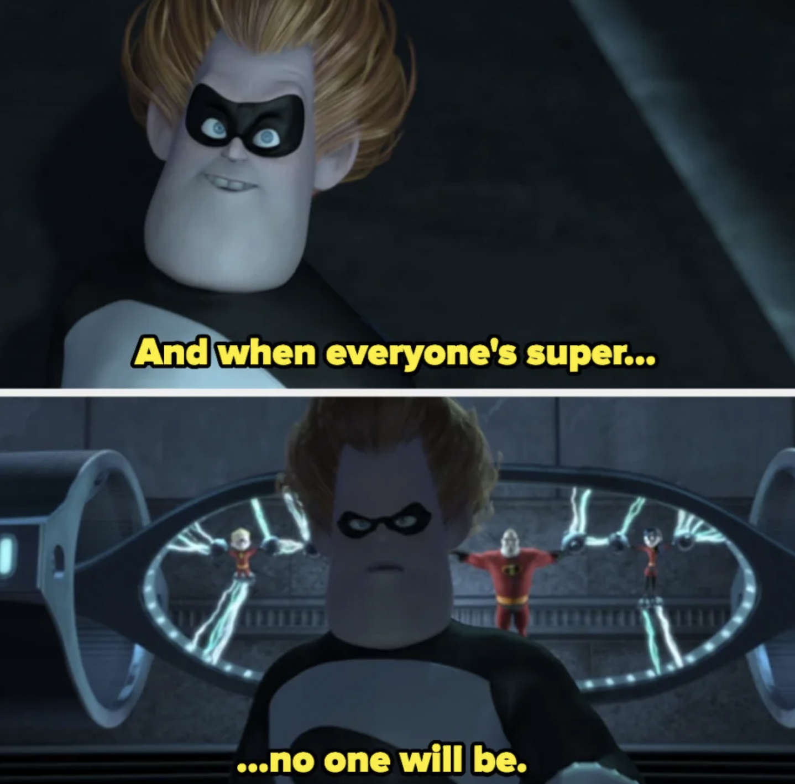
Why do these things matter?
We need to accept that we cannot create the perfect survey.
When everything is the focus, nothing is ascertained.

Slide 31
Exit Ticket Out
Independently, choose one of the Sorting Dials and create one question that you feel accurately reflects that Sorting Dial and that you would include on a survey to the school.
Why does your question matter?
Factors To Consider:
How long does it take to read the question?
How much of the text of the question helps you answer the question? / What is distracting?
What access needs should we consider when writing a survey question?
Do we require that all questions be answered? Why or why not?
Notes:
http://standardstoolkit.k12.hi.us/common-core/language-arts/language-arts-grades-9-10-common-core-standards/index.html

Slide 32
Works Cited
Krause, H. (2022, November 18). 4 Approaches to Multiple-Race Questions. Medium. https://heatherkrause.medium.com/4-approaches-to-multiple-race-questions-91c22d13ca0b
Hawaii Content & Performance Standards: Standards Toolkit » Language Arts Grades 9-10 Common Core Standards. (n.d.). Retrieved April 6, 2023, from http://standardstoolkit.k12.hi.us/common-core/language-arts/language-arts-grades-9-10-common-core-standards/index.html
Krause, H. (2022, April 28). Introducing: Identity Sorting Dials » We All Count. We All Count. https://weallcount.com/2022/04/28/introducing-identity-sorting-dials/
Pacific Islands | Countries, Map, & Facts | Britannica. (2023, March 9). https://www.britannica.com/place/Pacific-Islands
“You Were Never Even A Player”: People Are Sharing The Most Chilling TV And Movie Villain Quotes. (2022, July 24). Yahoo Finance. https://finance.yahoo.com/news/people-sharing-most-memorable-tv-164603990.html

